Slide 1
ciallo-agent：LLM-driven Genetic Circuit Compiler
Yizhou Jiang, Qinlin Zhang, Boyang Zhang, Arnouv Nayana
Email：jyz0410@bu.edu

Slide 2
Goal & motivation
Synthetic biology connection
Problem
Designing gene circuits normally requires domain knowledge of sensors, gates, reporters, UCF files, and toolchain details.
That makes rapid prototyping hard for students, biologists, and non-experts who can describe the behavior they want but not the compiler inputs.
The output is not just text: it maps to genetic sensors, logic constraints, reporters, and UCF-compatible representations.
That means the project acts like a front-end compiler for synthetic biology, bridging human intent and biological implementation.
Prompt → design bundle
Design a biosensor that can be based on multiple sensors and outputs.
↓
Design specifications + Verilog + Input/output JSON + Selected UCF + Cello runtime package

Slide 3
Short functionality
User request
Planner
Bundle builder
Validation & run
Natural-language goal, optional paper, optional custom parts
Extract sensors, outputs, chassis, logic, constraints
Generate DesignSpec, Verilog, JSON files, selected UCF
Schema checks, Cello execution, Tellurium simulation
What the user sees
What the system produces
One request box and one button to generate a design bundle.
Automatic selection of the most suitable official library record.
Output files exposed in the browser for inspection and export.
DesignSpec for the front-end request
Verilog and filtered input/output JSON
Base UCF or generated UCF fragment
Manifest + summary + optional Cello output

Slide 4
Short specification
Requirements
Generate schema-valid synthetic-biology bundle files.
Use an official or selected base library when possible.
Surface the chosen sensors, reporter, and logic to the user.
Support a “paper-assisted” path and a “custom components” path in the same studio.
Constraints
Official libraries are incomplete and directory layouts vary.
Many biological parameters are missing or only partially specified.
Windows encoding, JSON formatting, and environment setup can break the flow.

Slide 5
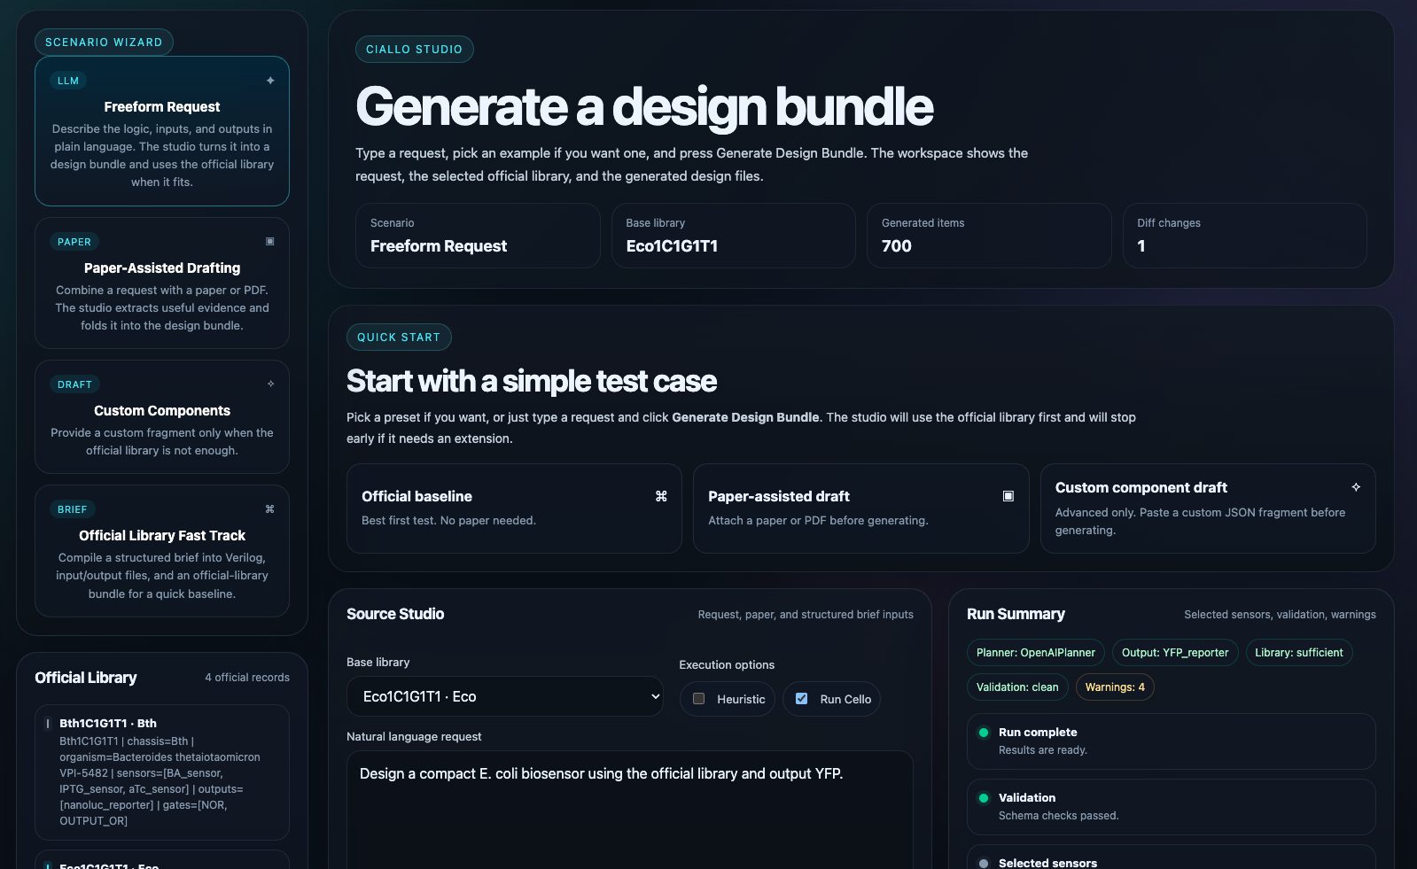
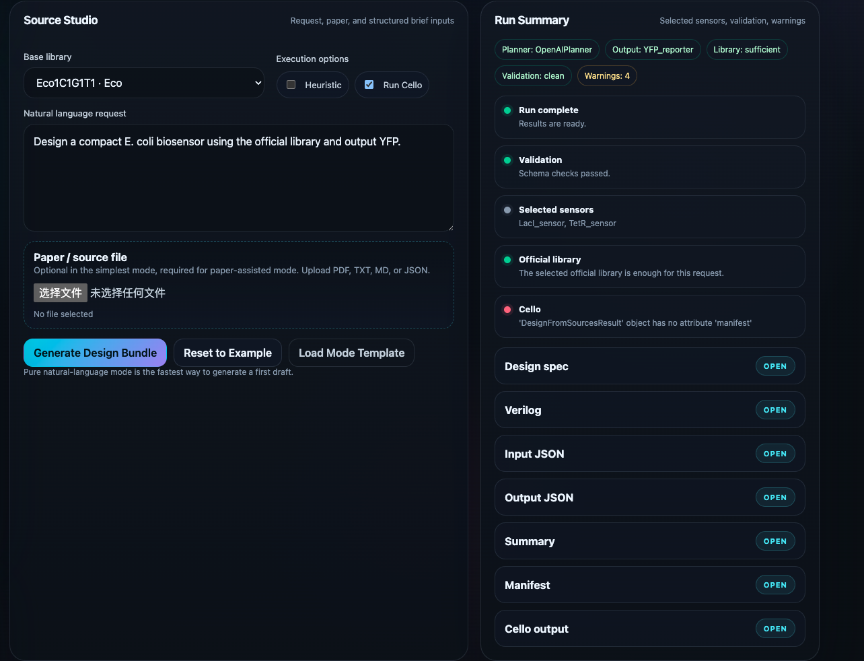
Short specification
Request parsing: extract chassis, sensor names, reporter, and logic hints from plain English.
Library selection: match the request against indexed official records such as Eco1C1G1T1.
Bundle generation: emit DesignSpec, Verilog, selected input/output JSON, and summary files.
Optional extension path: derive UCF fragments from a paper or custom component draft.
Validation: check JSON schema compatibility before handing off to Cello.

Slide 6
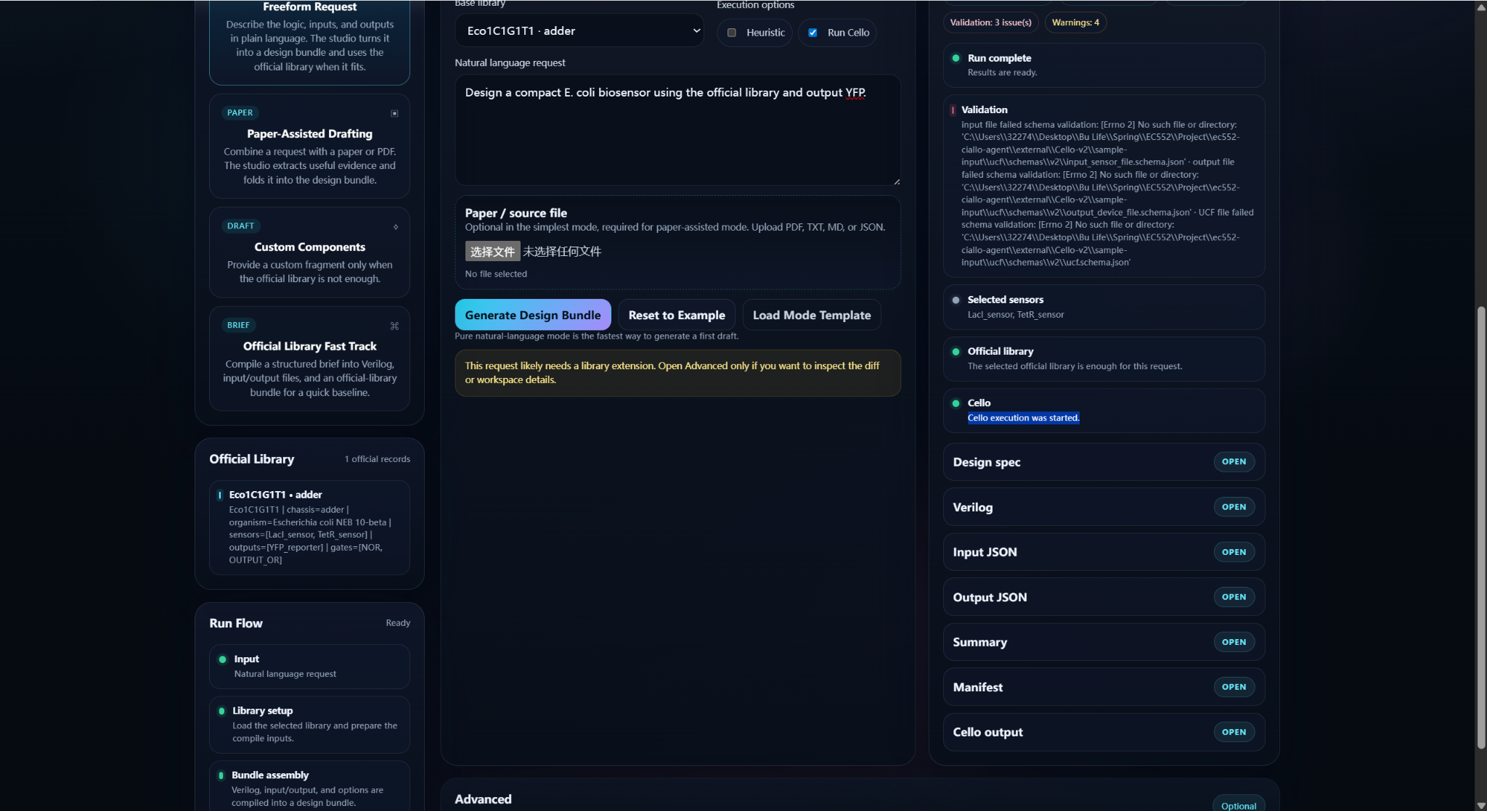


Detailed Functionality
Step 1 — Natural Language → Structured Design
User provides a high-level biological request
System selects compatible sensors from the official library
Planner translates intent into a formal design specification
Step 2 — Logic Abstraction via Verilog
Generated Verilog encodes circuit logic:
Abstracts biological behavior into digital logic
Enables compatibility with synthesis tools (Cello / Yosys)
Transforms biological logic into a computable intermediate representation

Slide 7
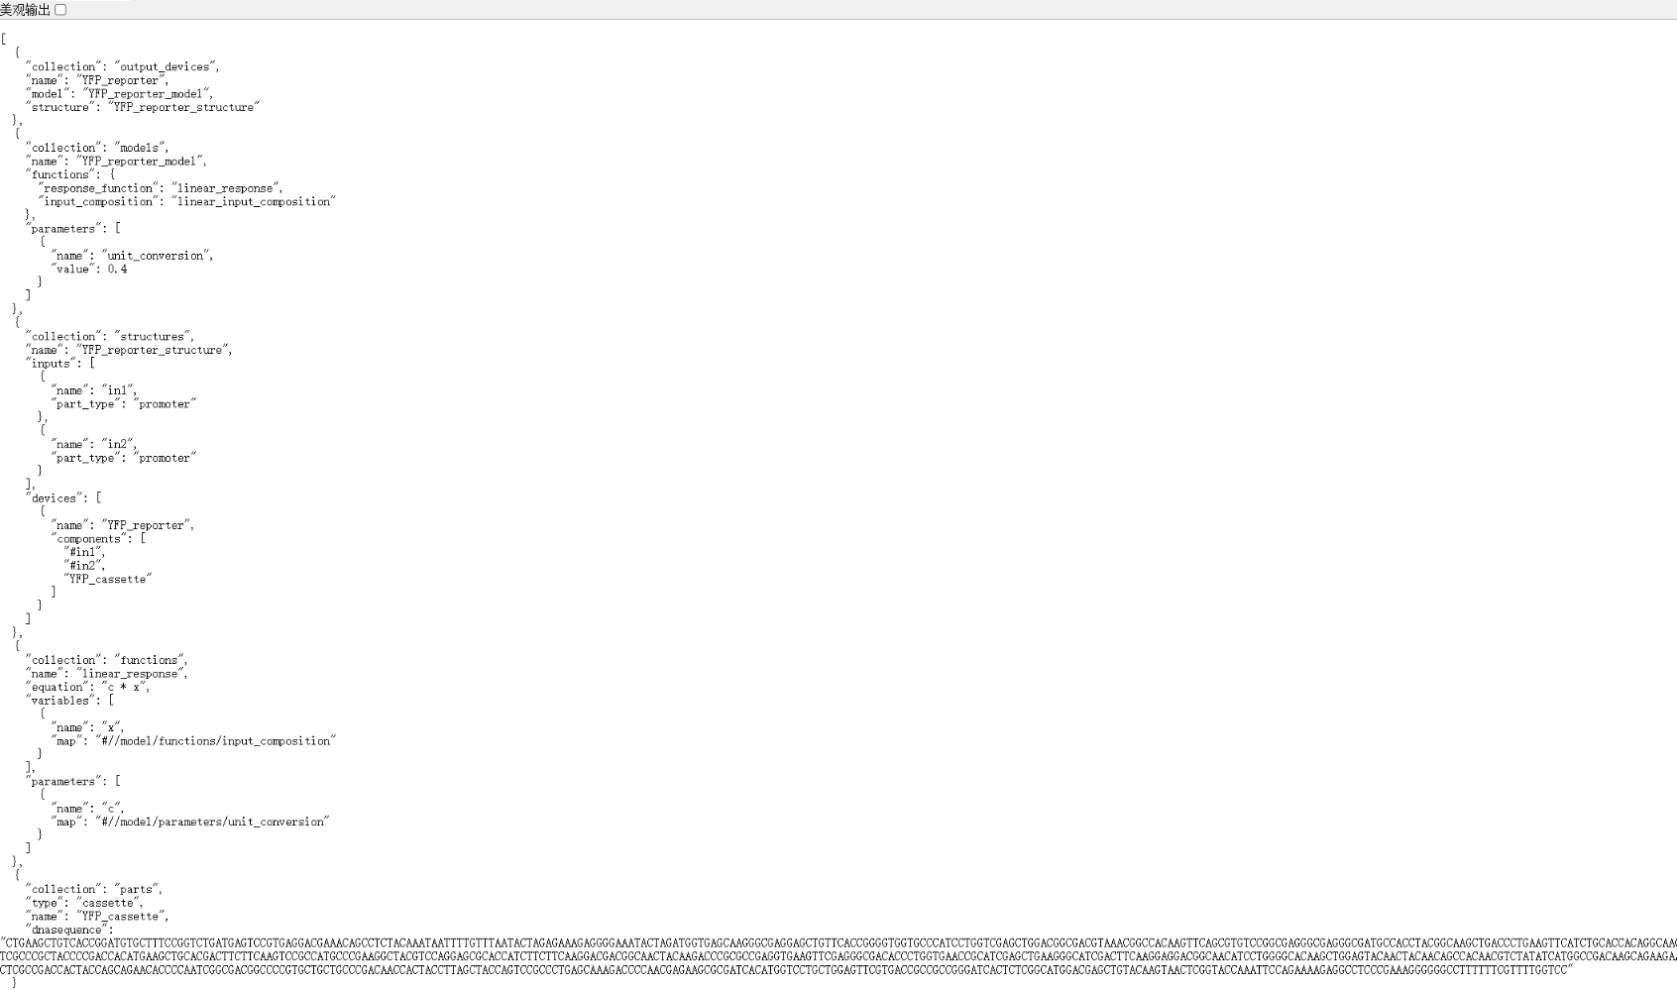
Detailed Functionality
This JSON represents the transition from logical design to biological implementation.
It defines the output device, maps inputs to biological components, and specifies functional behavior.
Unlike Verilog, which captures abstract logic, this layer encodes how the circuit can be physically realized.
This is the key step that makes the design compatible with Cello.

Slide 8
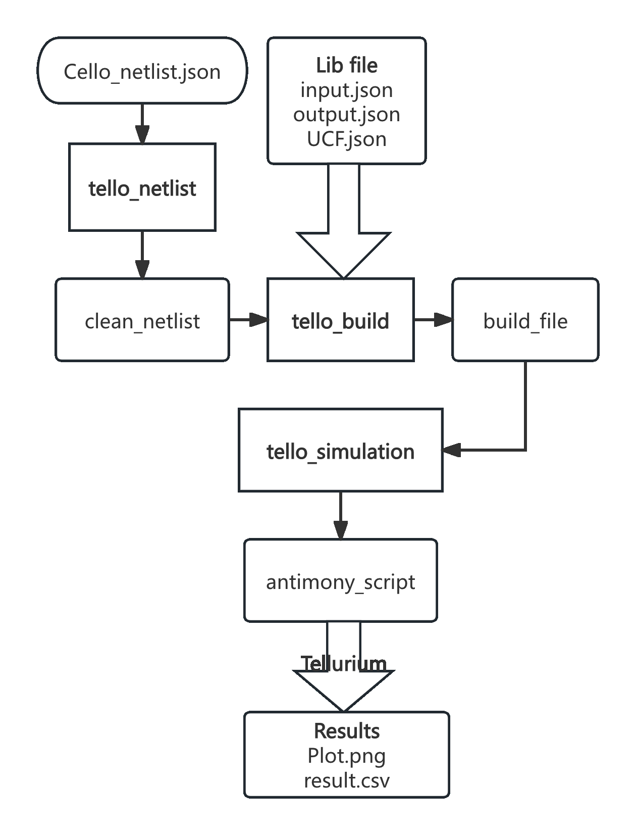
Detailed Functionality

Slide 9
Detailed architecture
Web app / CLI
Design pipeline
UCF drafts
Cello interface
Tellurium / outputs
User input, mode selection, file upload
Prompt parsing, library matching, request normalization
Base-UCF merge, custom parts, JSON generation
Bundle files, validation, Docker invocation
Simulation, summary, manifest, artifacts
Files that make the architecture tangible
Design tradeoff
DesignSpec.json • Verilog • input.json • output.json • base/generated UCF.json • summary.md • manifest.json • cello_output/*
We preferred explicit intermediate artifacts over a black-box pipeline so we could inspect every step, debug failures, and show the work in class.

Slide 10
One Clear Technical Example
Bridging LLM Output with Cello Constraints
Problem
LLM-generated designs are often syntactically valid but not compatible with Cello’s strict input requirements.
Our Solution
We designed a pipeline that:
Translates natural language into structured design artifacts
Constrains outputs using an official biological library
Generates Cello-compatible inputs (Verilog + JSON)
Result
Successfully triggers Cello execution and reaches logic synthesis

Slide 11
Successes
Technical successes
We achieved an end-to-end workflow from natural language to structured synthetic-biology artifacts.
We indexed an official library, selected a matching baseline, and generated inspectable files.
We integrated a browser studio, validation logic, and a Tellurium-based simulation view.
We debugged real engineering problems: encoding issues, malformed JSON, library layout mismatches, and Windows environment problems.
Team contributions
Yizhou Jiang: UCF generation; library handling; and JSON validation
Boyang Zhang: Web Frontend Agent Optimization; Request Parsing; Web Frontend Agent Optimization
Arnouv Nayana : Cello integration; circuit synthesis pipeline debugging
Qinlin Zhang: Cello/Tellurium testing, debugging, and evaluation

Slide 12
Failures, tradeoffs, and what we would do differently
What failed or was fragile
What we would do next
Due to limited domain expertise in synthetic biology, many LLM-generated designs were not sufficiently well-structured to meet Cello input requirements. In contrast, designs derived from literature sources were consistently valid and could be successfully processed and simulated.
Build a cleaner curated biological library instead of relying only on messy upstream sample inputs.
Strengthen prompt normalization so the user can omit more details safely.
Add better error handling in the web app so unsupported cases return guidance instead of 500-style failures.
Expand the simulation layer to compare expected logic and measured dynamics across multiple designs.

Slide 13
DEMO

